Slide 1
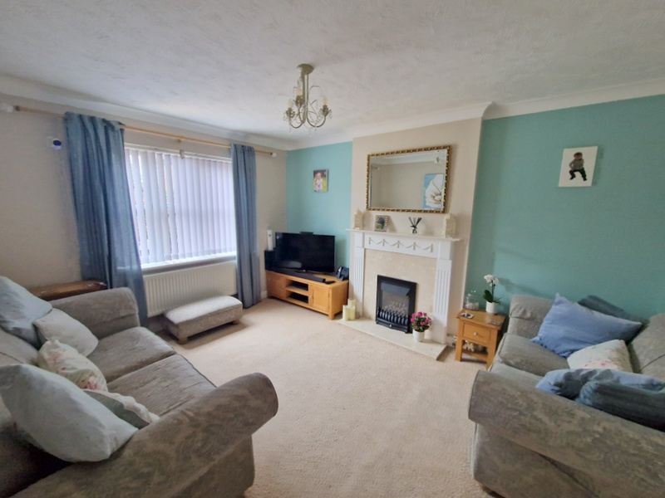
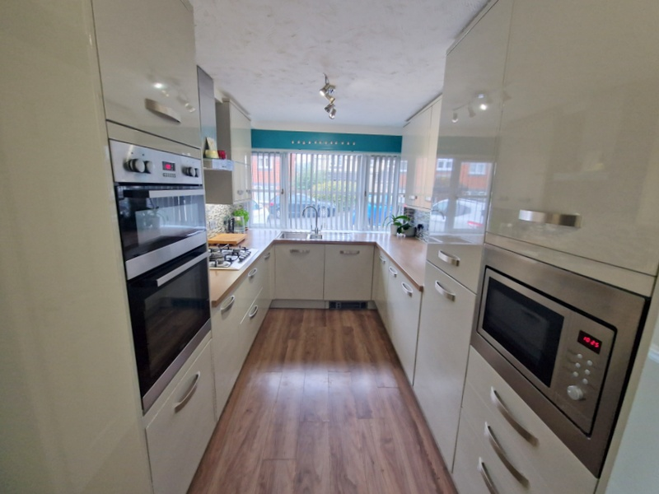
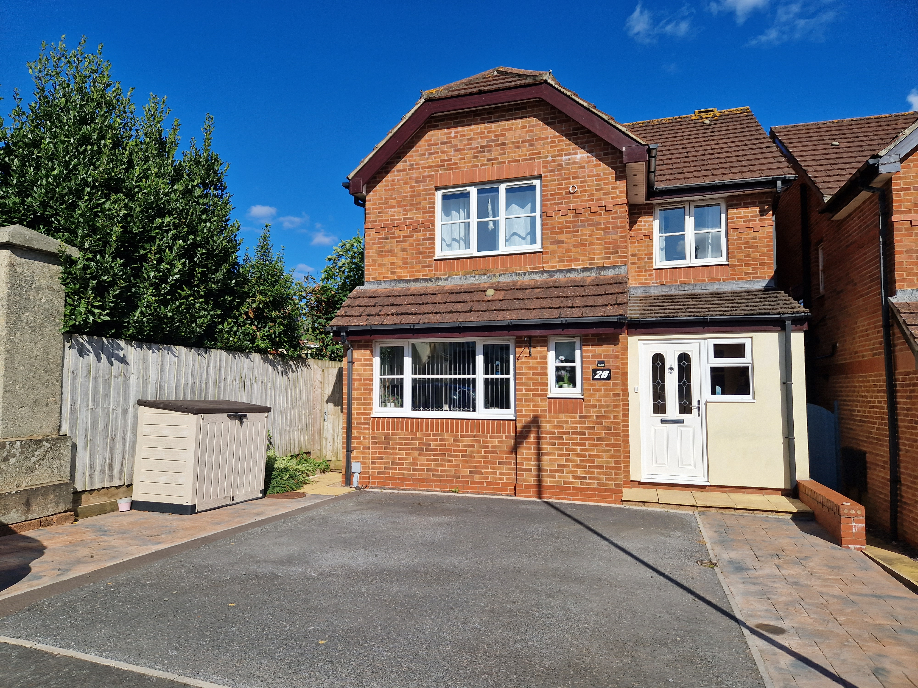
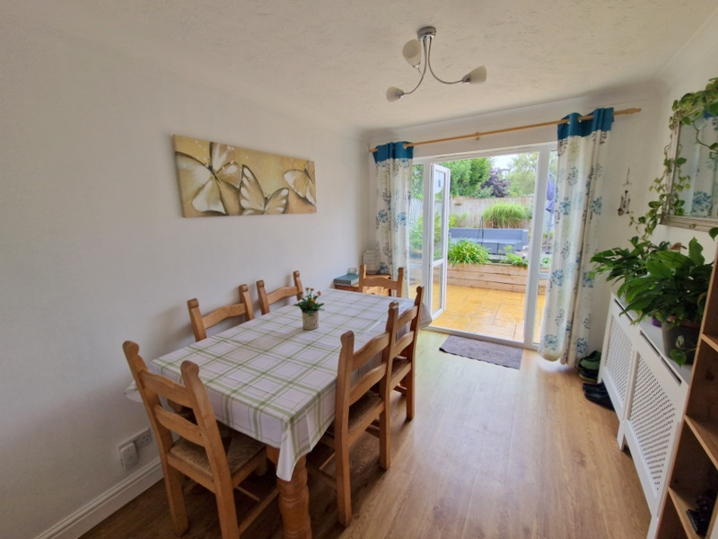
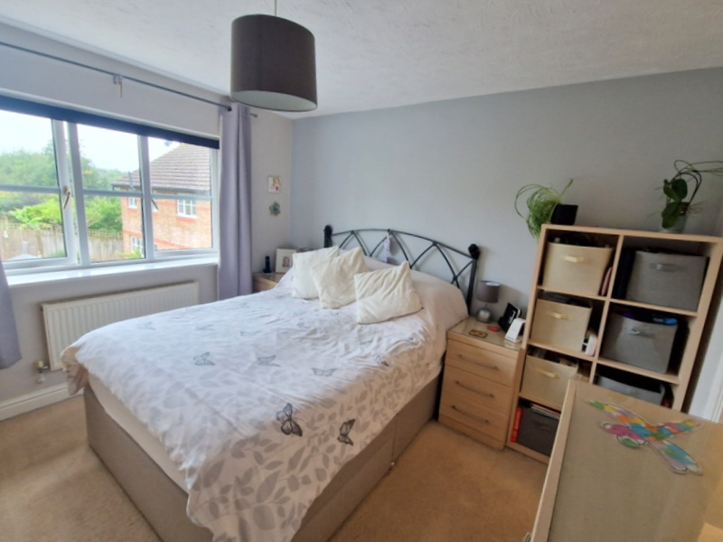
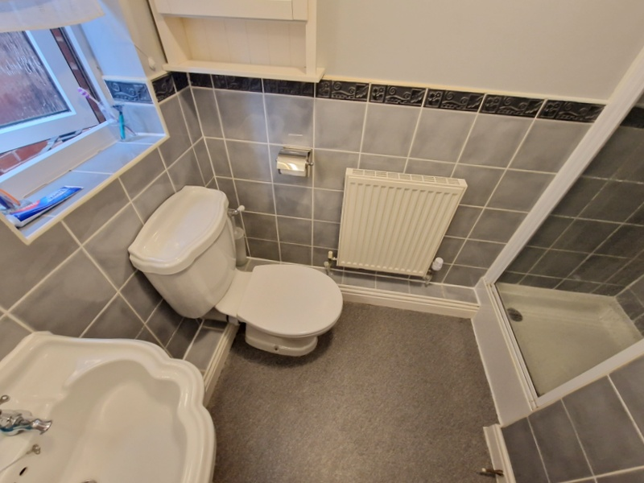
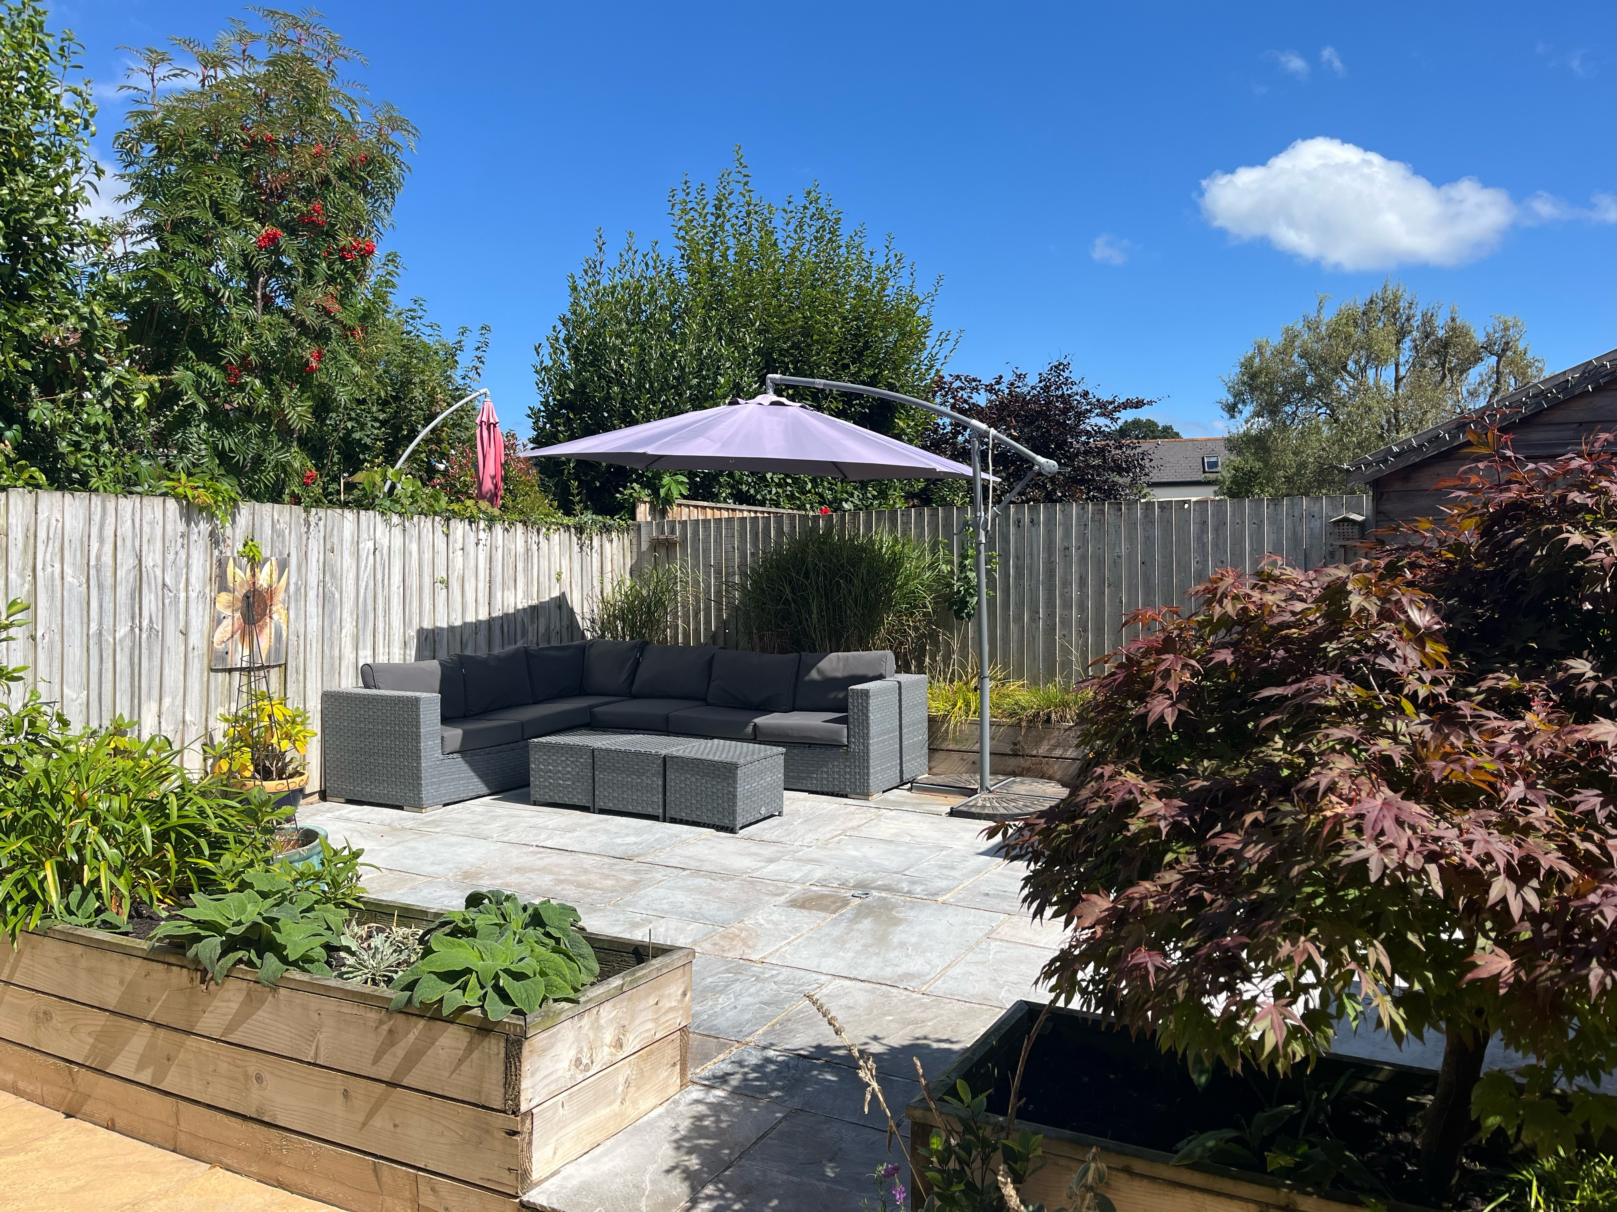
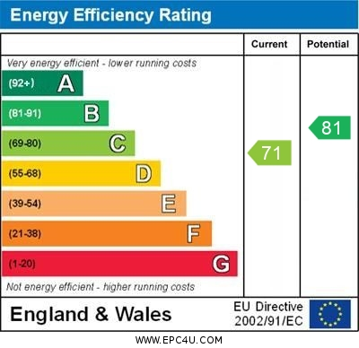
www.pennys.net
26 Old Bystock Drive, Exmouth, EX8 5RB
GUIDE PRICE £470,000
TENURE Freehold
A Beautifully Presented And Much Improved Detached Family Home Enjoying An Enviable Location On A Sought After Development With Landscaped Rear Garden And Double Width Driveway
Good Size Entrance Porch * Reception Hall * Lounge * Separate Dining Room * Stylish Well Appointed Kitchen * Study/Family Room * Ground Floor Cloakroom/Wc * Four Bedrooms * En-Suite Shower Room/Wc * Family Bathroom/Wc * Gas Central Heating * Double Glazing * Viewing Strongly Recommended
Pennys Estate Agents Limited for themselves and for the vendor of this property whose agents they are give notice that:- (1) These particulars do not constitute any part of an offer or a contract. (2) All statements contained in these particulars are made without responsibility on the part of Pennys Estate Agents Limited. (3) None of the statements contained in these particulars are to be relied upon as a statement or representation of fact. (4) Any intending purchaser must satisfy himself/herself by inspection or otherwise as to the correctness of each of the statements contained in these particulars. (5) The vendor does not make or give and neither do Pennys Estate Agents Limited nor any person in their employment has any authority to make or give any representation or warranty whatever in relation to this property.
PENNYS ESTATE AGENTS
2 Rolle House, Rolle Street, Exmouth, Devon, EX8 2SN
Tel: 01395 264111 EMail: help@pennys.net

Slide 2
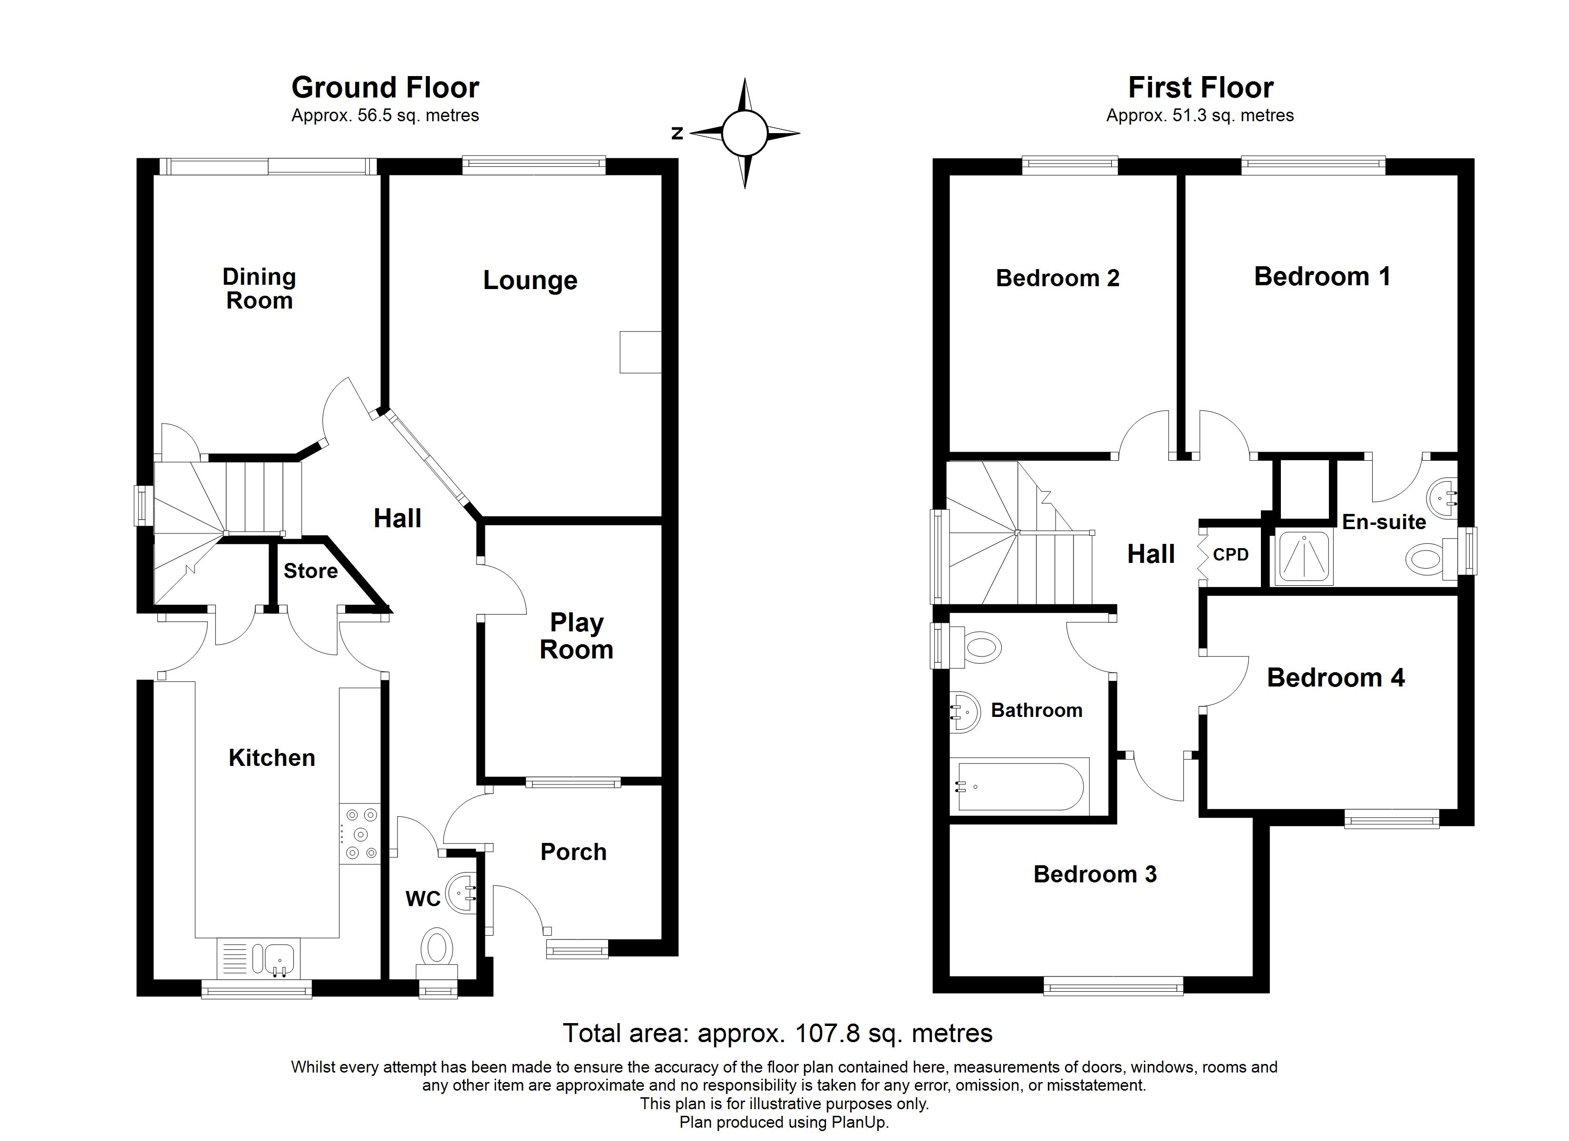
26 Old Bystock Drive, Exmouth, EX8 5RB
THE ACCOMMODATION COMPRISES: Composite front door with pattern glass window inset to:
ENTRANCE PORCH: 2.03m x 1.83m (6'8" x 6'0") A very useful addition to the property with uPVC double glazed window to front aspect, coat rack, radiator, inner glazed panel door to:
RECEPTION HALL: With feature wood effect flooring, radiator housing feature radiator cover, coved ceiling, turning staircase rising to first floor landing with uPVC double glazed window on half landing.
GROUND FLOOR CLOAKROOM/WC: With pedestal wash hand basin with tiled splashback and fitted mirror over, WC, chrome heater towel rail, uPVC double glazed window with patterned glass.
LOUNGE: 4.19m x 3.33m (13'9" x 10'11") With feature fire surround with marble hearth and inset housing living flame coal effect gas fire, TV point, radiator, coved ceiling, uPVC double glazed window overlooking the rear garden.
DINING ROOM: 3.35m x 2.54m (11'0" x 8'4") With uPVC double glazed double doors with picture windows to either side opening onto the rear garden, feature wood effect flooring, radiator housing feature radiator cover, access to understairs cupboard, coved ceiling.
KITCHEN: 4.47m x 2.44m (14'8" x 8'0") A quality well appointed kitchen with a range of wood effect worktops with inset one and a half bowl single drainer sink unit, inset five ring gas hob, cupboards and deep drawer units, integrated dishwasher beneath worktops, attractive tiled surrounds, range of wall mounted cupboards with concealed lighting beneath, integrated fridge and freezer, built-in double oven with cupboards above and below, integrated microwave oven with drawer units beneath and cupboard over, understairs cupboard, utilities cupboard, plumbing for automatic washing machine and tumble dryer space, further access to understair storage cupboard, ceiling spotlighting, coved ceiling, modern gas baxi boiler for hot water and central heating housed in matching kitchen unit, uPVC double glazed window to front aspect, plinth lighting and heater, uPVC double glazed door giving access to outside.
STUDY/PLAY ROOM: 3.1m x 2.11m (10'2" x 6'11") With radiator, tiled flooring, uPVC double glazed window overlooking entrance porch.
FIRST FLOOR LANDING: Access to roof space via loft ladder, linen cupboard with slatted shelving, chrome heated towel rail. Airing cupboard with water cylinder and slatted shelving.
BEDROOM 1: 3.4m x 3.3m (11'2" x 10'10") Radiator, TV point, uPVC double glazed window to rear aspect.
EN-SUITE SHOWER ROOM/WC: Fitted with shower cubicle comprising shower unit with fixed rainfall shower head hose and detachable shower head hose, tiled cubicle and shower splash screen door, pedestal wash hand basin, WC, radiator, matching part tiled walls, mirror fronted medicine cabinet, light/shaver socket, ceiling extractor fan, uPVC double glazed window with patterned glass.
BEDROOM 2: 3.4m x 2.59m (11'2" x 8'6") With radiator, uPVC double glazed window to rear aspect.
BEDROOM 3: 3.68m x 2.67m (12'1" x 8'9") maximum overall measurement into doorway. Radiator, uPVC double glazed window to front aspect.
BEDROOM 4: 2.87m x 2.24m (9'5" x 7'4") With radiator, uPVC double glazed window to front aspect.
BATHROOM/WC: 1.88m x 1.83m (6'2" x 6'0") Comprising bath with shower attachment, shower splash screen, vanity wash hand basin, WC, fully tiled walls, chrome heated towel rail, fitted mirror with light/shaver socket over, ceiling extractor fan, uPVC double glazed window with pattern glass.
OUTSIDE: To the front of the property is a double width driveway with parking for two cars, edged with patio areas and decorative stone hardstanding area providing off road parking. Side gates and pathway gives access to the rear garden, outside cold water tap. The rear garden is a lovely feature of the property, being landscaped with ease of maintenance in mind comprising of two good size patio areas providing excellent outside entertainment areas, raised shrub beds, timber garden shed. The garden is fully enclosed by timber fencing and enjoys a sunny aspect. Outside lighting.
Mortgage Assistance: We are pleased to recommend Meredith Morgan Taylor, who would be pleased to help no matter which estate agent you finally buy through. For a free initial chat please contact us on 01395 264111 to arrange an appointment. Your home may be repossessed if you do not keep up repayments on your mortgage. Meredith Morgan Taylor Ltd is an appointed representative of Openwork Limited, a trading style of Openwork Ltd which is authorised and regulated by the Financial Conduct Authority (FCA).
FLOOR PLAN:

